Slide 1
Instructor Training Slides
MMPI®-3 Instructor Training Slides, University of Minnesota Press,
Copyright for all MMPI® materials are held by the Regents of the University of Minnesota

Slide 2
Part 5:
Unit 1: Diversity-Sensitive Personality Assessment
Unit 2: Diversity-Sensitive Assessment with the MMPI-3
Part 5:
Diversity-Sensitive Assessment

Slide 3
Diversity-Sensitive Personality Assessment

Slide 6
Diversity-Sensitive Personality Assessment
APA Inclusive Language Guidelines

Slide 9
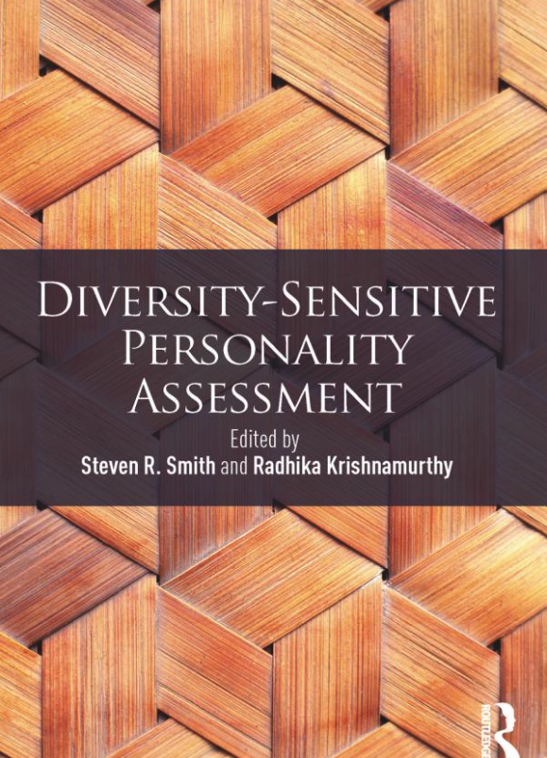
Diversity-Sensitive Personality Assessment
Smith & Krishnamurthy (2018)

Slide 10
Diversity-Sensitive Personality Assessment
Smith & Krishnamurthy (2018)
  Human Diversity not limited to race and ethnicity (though these are important elements)
  Book includes chapters on
    Race and ethnicity
    Gender
    Sexual orientation and gender identity
    Religion
    Cognitive and physical disability
    Nationality
    Regionalism
    Age
    SES

Slide 11
Diversity-Sensitive Personality Assessment
Cimbora & Krishnamurthy (2018)
  As clinical psychologists, we immerse ourselves in the realm of psychological disorder.
  We are trained to perform diagnostic assessments focused on presenting problems and symptoms…
  But do we know enough about the environment and world inhabited and experienced by the client, or put another way,
  do we sufficiently consider the contexts in which the evaluation is embedded?

Slide 12
Diversity-Sensitive Personality Assessment
Burnes & Smith (2018)
  The former version of the MMPI assumed that sexual orientation, and/or transgression of cultural and social gender norms were deviant or pathological through use of scale 5 (MF; Masculinity/Femininity)
  Although this inventory has now been restructured (MMPI-2-RF) the restructured and newer scales of the measure do not explicitly make the connection between specific symptoms and cultural factors unique to LGBT communities

Slide 13
Diversity-Sensitive Personality Assessment
Aboouezzeddine, Hill, Cambell, & Smith, 2018)
  Discuss associations between MMPI L scale and religion
  and between RC Scales and spirituality
Roysircar & Krishnamurthy, (2018)
  Discuss associations between MMPI scores and acculturation among immigrants
Porras, Pyland, Stabb, & Smith (2018)
  Discuss associations between MMPI scores and SES or class

Slide 14
Diversity-Sensitive Personality Assessment
Fundamental question:
  Do associations between MMPI scores and diversity-related variables reflect:
    Bias
    Psychological challenges associated with membership in diverse groups and the intersections among them
    or some combination of both
  The answer to this question requires:
    Empirical data
    Thought

Slide 15
Diversity-Sensitive Assessment with the MMPI-3

Slide 16
Overview
Original MMPI was developed and normed with a sample that was
  exclusively White
  farmers and laborers w/
  with an average of 8 years of education
As the test has evolved, it’s been used successfully with
  diverse groups within the U.S.
  many languages and cultures outside the U.S.

Slide 17
Original MMPI
Dahlstrom & Gynther (1986) reviewed the literature on Black-White comparisons
  Early studies focused on mean score differences and identified consistent differences on L, F, and Clinical Scales 8 and 9
  This had led Gynther (1972) to propose that separate norms be developed for Black individuals
  However, subsequent research, where Blacks and Whites were matched on potentially confounding variables (e.g., education, age) showed no consistent differences

Slide 18
Original MMPI
Campos (1989) reviewed the results of 16 studies comparing MMPI scores of Hispanics and Whites
  Concluded that when language and acculturation factors were considered, the only consistent finding was that Hispanics scored higher on L
Findings comparing American Indians and Whites:
  Mixed, with some showing higher scores for one group and other the opposite
Mixed results also reported for Asian American-White comparisons

Slide 19
Original MMPI
Studies with gender diverse individuals found moderate elevations among “transexuals”
Mostly on Scale 5
Gender diverse samples scored lower on other scales
Small sample sizes limited the power of these studies

Slide 20
Original MMPI
Older individuals tended to:
  score higher than younger ones on Clinical Scales 1, 2, 3, and 0
  and lower on Scales 4 and 9
Most of these studies relied on cross-sectional designs
  Razing the possibility that differences observed may be a product of generational dissimilarities

Slide 21
Original MMPI
Dahlstrom (1986) reviewed the literature on regional score differences within the US
  Concluded that code type patterns did not differ as a function of region
Dahlstrom (1986) also reviewed the literature on score differences among religions:
  “there may well be systematic differences, but they are likely to be small and must be considered in the larger view of the individual being tested”

Slide 22
Original MMPI
Pritchard and Rosenblatt (1986) noted that the meaning of Black-White group differences was ambiguous insofar as the possibility of bias was concerned:
    Unless the black and white subgroups in a sample are matched for psychopathology… [i]t is always possible that such mean differences in unmatched groups are due to actual subgroup differences in psychopathology that the MMPI accurately detects
An important corollary:
  The absence of differences is not evidence of the absence of bias

Slide 23
Original MMPI
Pritchard and Rosenblatt (1986) went on to advocate for research that focused on a comparison of predictive validity
Very little such research was conducted with the original MMPI

Slide 24
MMPI-2
Timbrook & Graham (1994) compared the Clinical Scale scores of Blacks and Whites in the MMPI-2 normative sample
  No difference exceeded 5 T score points (the standard for a clinically meaningful difference)
In a subsample of married or cohabitating normative sample members who completed personality rating forms for each other
  Prediction accuracy did not differ significantly for men
  For women, Scale 7 underpredicted anxiety ratings for Black women

Slide 25
MMPI-2
A general absence of differential predictive validity in Black-White comparisons was reported by
  McNulty et al. (1997)
  Arbisi et al. (2002)
  Castro et al. (2008)
Studies of other racial and ethnic minorities did not include predictive validity comparisons

Slide 26
MMPI-2
Studies of American Indians found that community samples scored significantly higher than the normative sample on several scales (Greene et al, 2003; Pace et al., 2006)
Hill et al. (2010) identified 30 MMPI-2 items that contributed to substantial group differences
And recommended that separate norms be developed for American Indians

Slide 27
MMPI-2
Using a qualitative research design, Hill et al. (2010) identified nine themes among the 30 items:
  Core belief systems
  Experiences with racism and discrimination
  Conflicting epistemologies
  Living in two worlds
  Community connectedness
  Responsibility and accountability to the community
  Traditional knowledge
  Stories as traditional knowledge
  Language and historic loss

Slide 28
MMPI-2
Caron and Archer (2006) examined MMPI-2 scores of individuals evaluated for possible gender reassignment surgery
Contrary to their expectations, the gender reassignment sample produced scores very similar to the MMPI-2 normative sample
They noted that contrary to prior MMPI studies that reported significant elevations, their sample was made up of a highly selected individuals who had met stringent criteria prior to the referral

Slide 29
MMPI-2
Miach et al (2000) also studied individuals seeking gender reassignment surgery
The group was divided into those with and without a diagnosis of Gender Identify Disorder (now called Gender Dysphoria)
Those without the diagnosis scored similar to the MMPI-2 normative sample
Those with GID scored substantially higher on scales that reflect dysphoric affect

Slide 30
MMPI-2-RF
Castro et al. (2008) examined Black-White differences on the RC Scales
Black and White subsamples differed substantially on SES-related variables
Blacks scored substantially higher than Whites on RC1, RC3, RC6, and RC8
Extra-test criteria were available to compare the predictive validity of RC1, RC4, and RC8
Regression analyses found no evidence of predictive bias

Slide 31
MMPI-2-RF
Monnot et al. (2009) compared the predictive validity of the RC Scales using a large sample of psychiatric inpatients receiving treatment for substantive abuse
Predictive validity analyses were conducted using self-administered SCID scores
Regression analyses detected negligible to small effect sizes for slope and intercept bias (all accounting for less than 5% and most less than 4% of the variance in diagnoses)

Slide 32
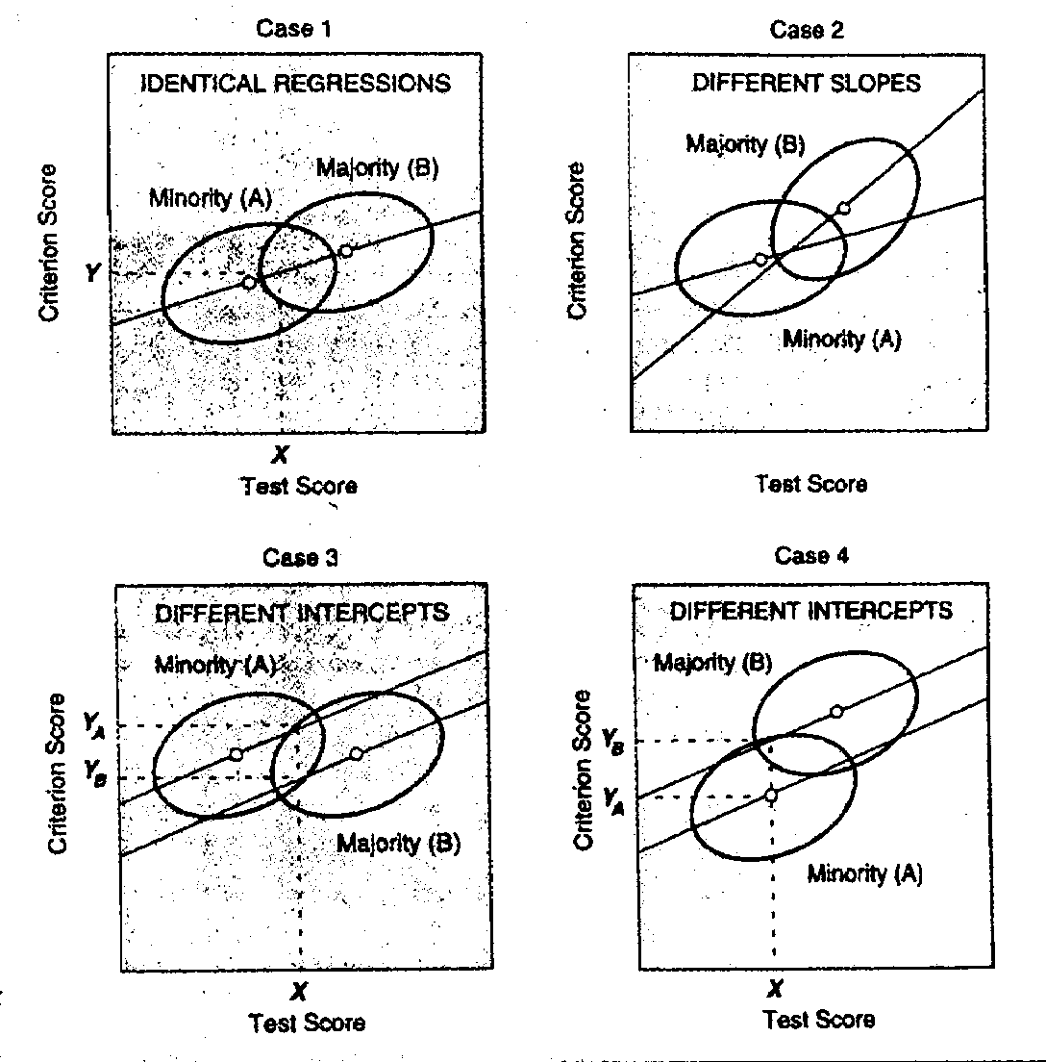
Slope & Intercept Bias in Predicting Criterion Scores

Slide 33
Slope & Intercept Bias in Predicting Criterion Scores
Yc
Yc
X_{CA}
X_{CB}
X_{CB}
X_{CA}
Minority Group Standing Under-estimated
Minority Group Standing Over-estimated

Slide 34
MMPI-2-RF
Monnot et al. (2009) compared the predictive validity of the RC Scales using a large sample of psychiatric inpatients receiving treatment for substantive abuse
Predictive validity analyses were conducted using self-administered SCID scores
Regression analyses detected negligible to small effect sizes for slope and intercept bias (all accounting for less than 5% and most less than 4% of the variance in diagnoses)
Some “bias” reflected greater validity for Blacks

Slide 39
MMPI-2-RF
Bryant et al. (2021)
  Reported descriptive MMPI-2-RF findings for a sample of transgender and gender diverse (TGD) individuals
    37 not receiving any mental health services
    48 receiving mental health treatment
  Three sets of comparisons:
    TGD no Tx versus normative sample
    TGD no treatment versus TGD in treatment
    TGD in treatment versus TGD in outpatient community mental health treatment

Slide 41
MMPI-3
MMPI-2-RF findings apply to the MMPI-3 (Technical Manual Appendix E)
No MMPI-3 replications published to date
MMPI-3 offers advantages in normative sample representation of current adult population:
  Demographics
  Experiences
  Spanish-language norms
  Gender-Diversity

Slide 42
Translations and Adaptations
MMPI
  First translation: Spanish for Cuba (1951)
  Ultimately translated into roughly 50 languages and used in over 70 countries
  No central coordination
MMPI-2
  University of Minnesota Press develops standard translation and adaptation guidelines
  Applied to MMPI-2-RF and MMPI-3 translations and adaptations as well

Slide 43
Translations and Adaptations
Guidelines for Developing Translations:
  Project Director
  Development of the Translation
  Back-Translation
  Evaluation by Language Service
  Bilingual Test-retest study
  Collection of Normative and Clinical Data
  Developing Standard Scores
  Prepublication Report

Slide 44
MMPI-3
MMPI-3 translations in development:
The Netherlands: Dutch/Flemish (PEN Pearson)
Italy: Italian (Giunti)
Japan: Japanese (Sankyobo)
Korea: Korean (Maumsarang)
Portugal: Portuguese (Hogrefe)
Spain: Spanish (TEA, owned by Hogrefe)
Greece: Greek/Cyprus (ISON)
Denmark: Danish (Hogrefe)
Norway: Norwegian (Hogrefe)
Sweden: Swedish (Hogrefe)
Germany, Switzerland & Austria: German (Hogrefe)
India: English-language and Hindi (Pearson India)
Israel: Hebrew (Carmel)

Slide 45
Best Practices for Diversity-Sensitive Use of the MMPI-3
Always consider the full context of the individual’s lived experiences
Consult relevant literature

Slide 46
End of Part 5

